Slide 1

Dear [Child/children’s name here],
Thank you for working so hard all year to be on the nice list. [ELF NAME] tells me you have been very good while he/she has been there, which is no surprise to me!
I’m writing to you because I need your help. [Tomorrow/today/etc] is [ELF’S NAME]’s birthday, however we cannot celebrate in the North Pole because he/she will be with you. That’s where you come in - I need you to throw him/her a surprise birthday party! I just know he/she would love to celebrate his/her special day with you all!
I have included everything you need to throw [ELF NAME] the best party! Thank you so much for helping me with this. You truly belongs on the nice list!
Merry Christmas,
Santa Claus

Slide 2
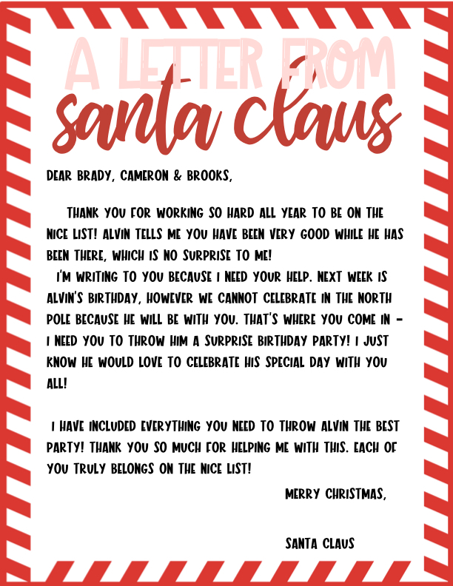
Sample

